Slide 1
Monte Carlo Path Tracing
Intro. definition & theorem
1.1 Solving the Rendering Equation
1.2 Monte Carlo Path Tracing
1.3 Random Walks and Markov Chains
1.4 Adjoint Equations and Importance Sampling

Slide 2

Intro. definition & theorem
Path tracing
Path tracing is a computer graphics Monte Carlo method of rendering images of three-dimensional scenes such that the global illumination is faithful to reality.

Slide 3
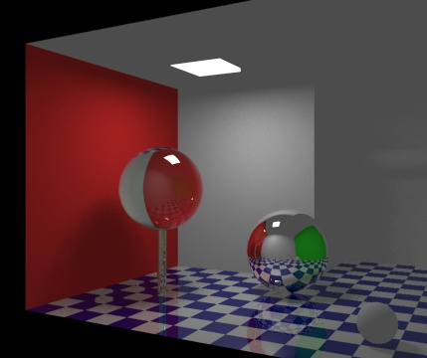
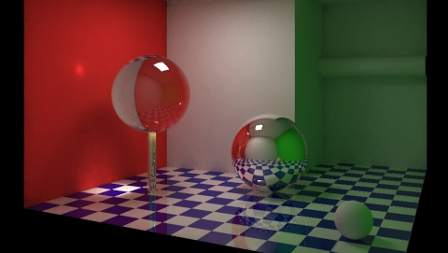
Intro. definition & theorem
Global illumination(GI)
Global illumination is a general name for a group of algorithms used in 3D computer graphics that are meant to add more realistic lighting to 3D scenes.
Direct Light & Indirect Light

Slide 4
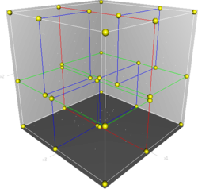
Intro. definition & theorem
K-D Tree(k-dimensional tree)
k-d tree is a space-partitioning data structure for organizing points in a k-dimensional space.

Slide 5
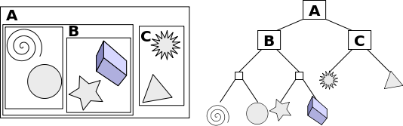
Intro. definition & theorem
A bounding volume hierarchy (BVH)
BVH is a tree structure on a set of geometric objects.
BVHs are often used in ray tracing to eliminate potential intersection candidates within a scene.

Slide 6
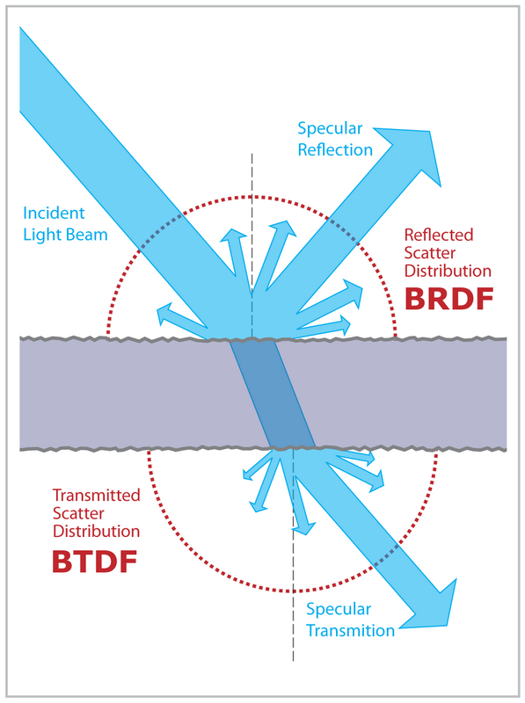

Intro. definition & theorem
BSDF(Bidirectional scattering distribution function)
BTDF(Bidirectional transmittance distribution function)
BRDF(Bidirectional reflectance distribution function)
Micorofacet theory

Slide 7

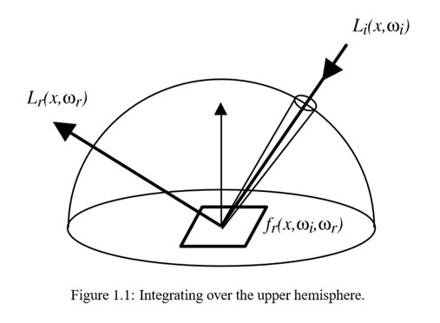

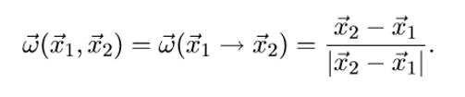


1.1 Solving the Rendering Equation
1
2
3
4

Slide 8
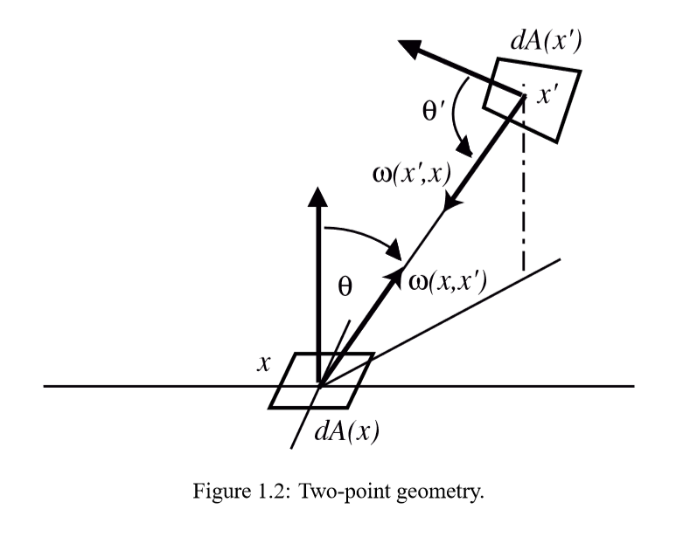




5
1
2
3
4
5

Slide 9


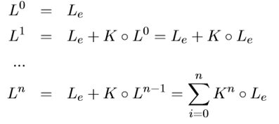



Slide 10





Note. Neumann series
If the Neumann series converges in the operator norm
p
||x|| < 1
q

Slide 11
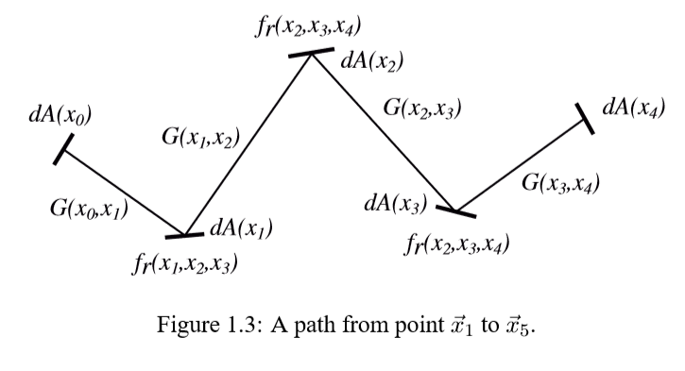
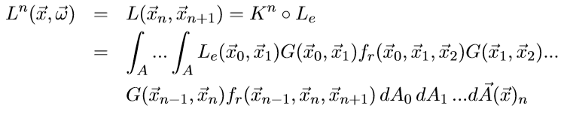

Slide 12

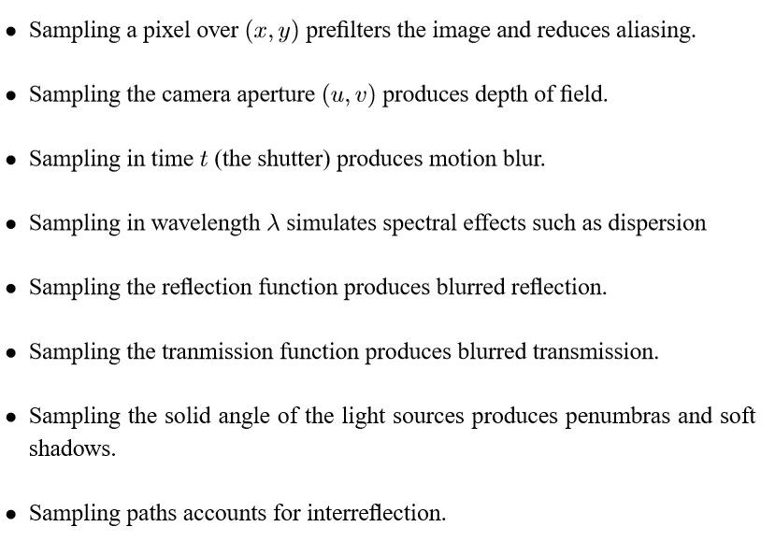

Slide 13
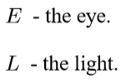
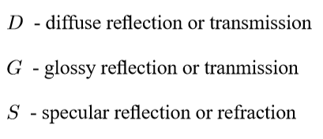
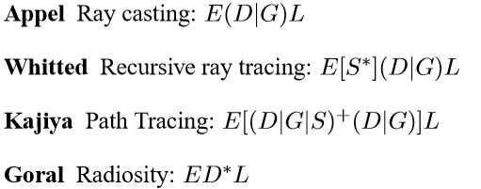
1.2 Monte Carlo Path Tracing

Slide 14
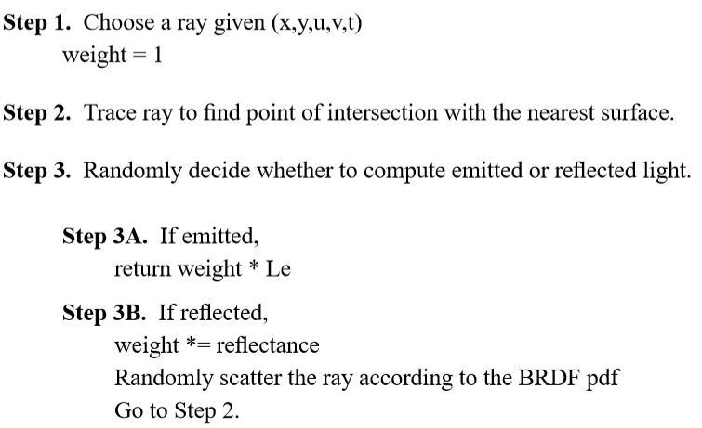
Original algorithm

Slide 15
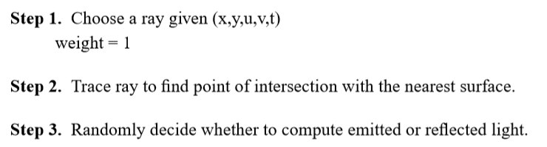
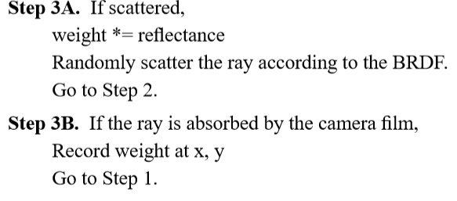
Variation algorithm

Slide 16
The above simple algorithms form the basis of Monte Carlo Path Tracing. However, we must be more precise. In particular, there are two theoretical and practical challenges.
Challenge 1 : Sampling an infinite sum of paths in an unbiased way
Challenge 2 : Finding gppd estimators with low variance.

Slide 17
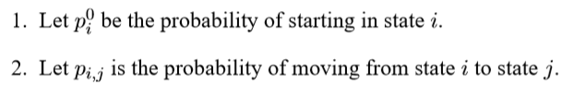
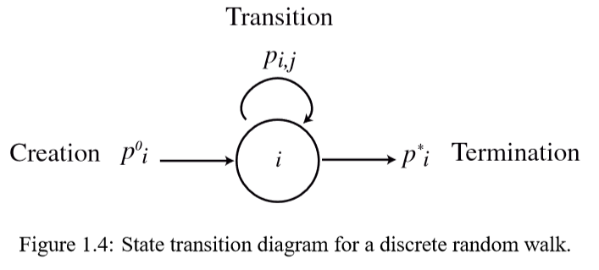


1.3 Random Walks and Markov Chains
A random walk is characterized by three distributions.

Slide 18
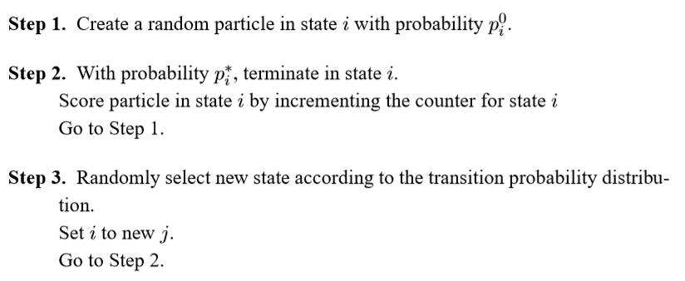

Slide 19
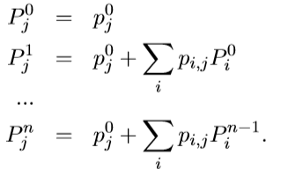
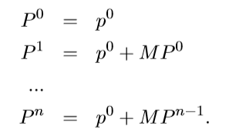



※ Neumann series

Slide 20

※ Refer to 8page.

Slide 21
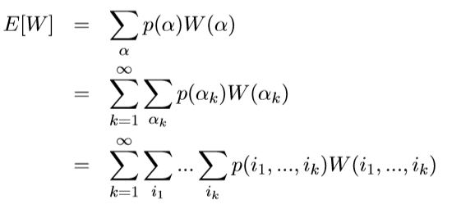

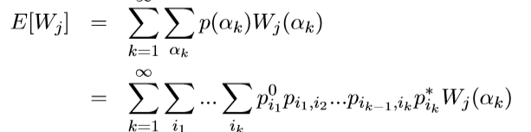

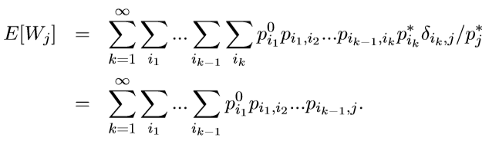

Slide 22

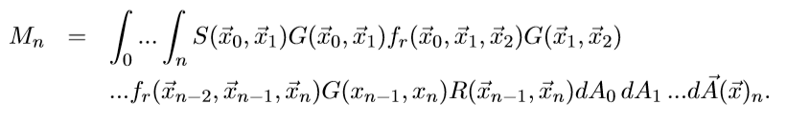


Slide 23
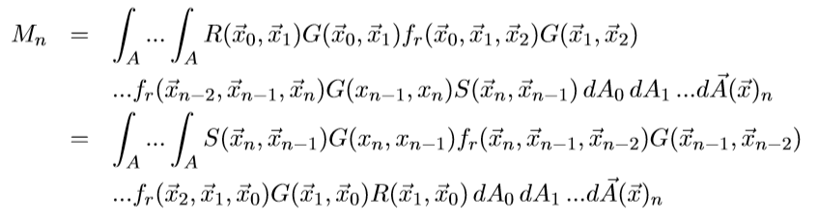


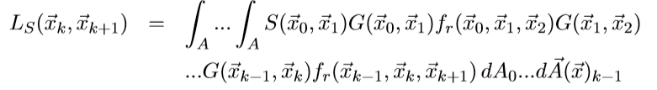
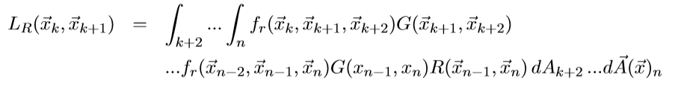


Slide 24
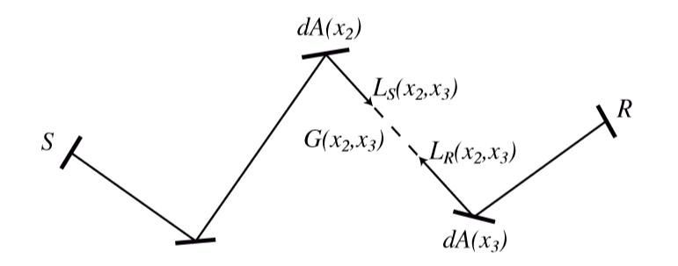




Slide 25


